Slide 1

EDA CASE STUDY (LENDING CLUB)
BY:- ADARSH DALMIA

Slide 2
BACKGROUND AND BUSINESS OBJECTIVE
BACKGROUND
BUSINESS OBJECTIVE
Lending Club stands as the premier peer-to-peer marketplace linking borrowers and lenders. Borrowers make applications via an online platform, receiving an internal score. Lenders then determine whether to offer a loan and the specifics of the loan, including interest rate, monthly payments, and duration. Among the favored offerings are credit card loans, debt consolidation loans, mortgages, and auto loans.
To systematically identify key variables that serve as robust predictors of default behavior, and to strategically integrate these findings into the decision-making framework governing loan approval or rejection.

Slide 3
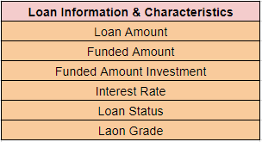
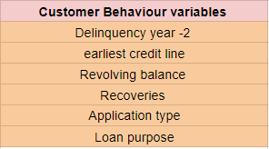
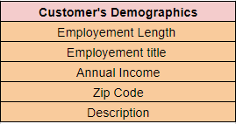
UNDERSTANDING DATA
Types of variables
Customer (applicant) demographic
Loan related information & characteristics
Customer behavior (if the loan is granted)

Slide 4
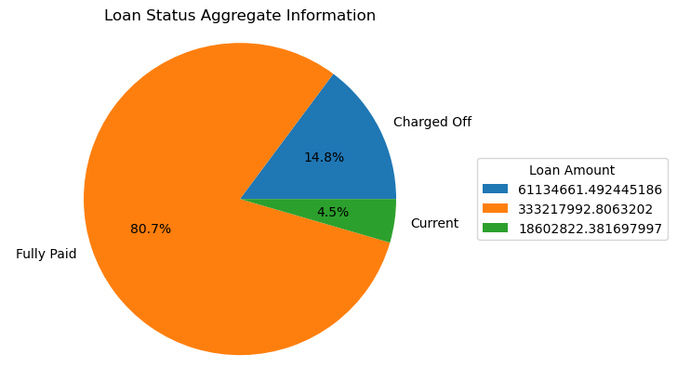
DATA UNDERSTANDING - OVERALL DEFAULT RATE IS 14.8%

Slide 5
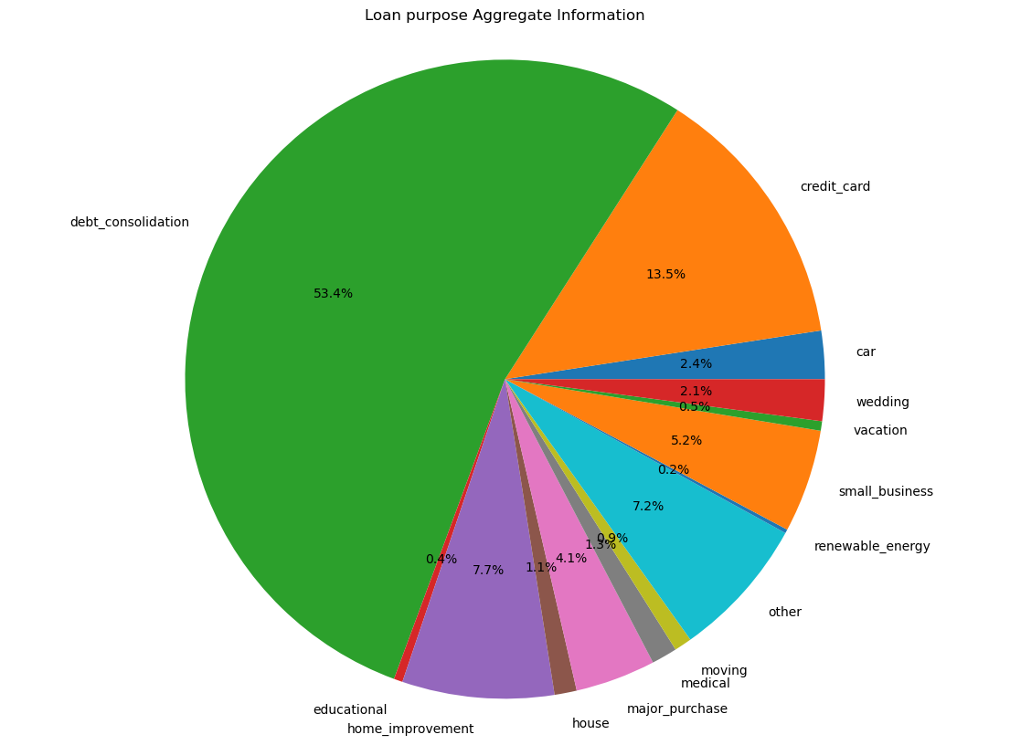
LOAN PURPOSE DISTRIBUTION : DEBT CONSOLIDATION LOAN IS THE MOST POPULAR
•53.4% debt consolidation loans
•13.5% credit card loans
•7.7% home improvement loans
•7.2% other
• 5.2 small business
•4.1 major purchase

Slide 6
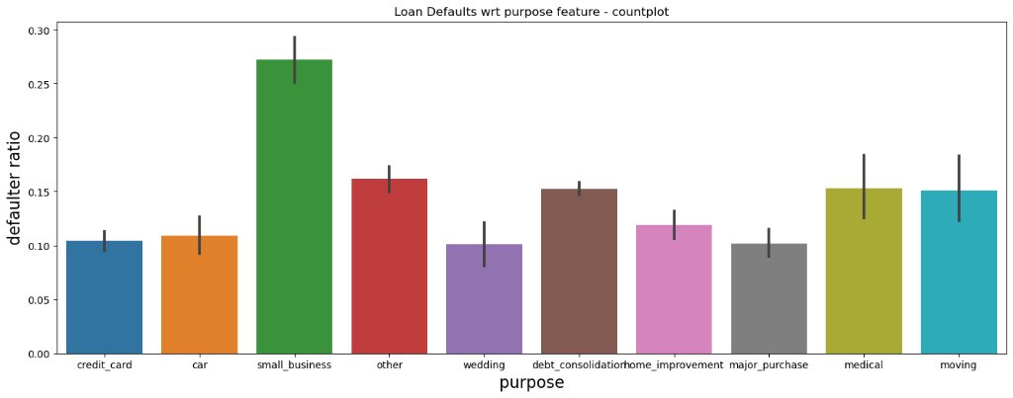
Loan Defaulters With Respect To Purpose
Small business: 27%
Other: 17%
Debt consolidation: 16%
Medical & Moving: 15%
Car: 11%
Credit card: 10%

Slide 7
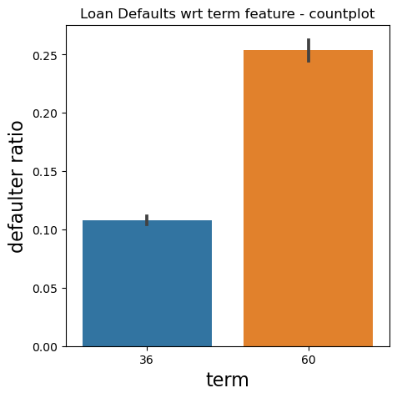
Loan Defaulters With Respect To Term Feature
From the graph for 'term' we can interpret that the defaulters rate is increasing with respect to term, hence the chances of loan getting defaulted is less for 36m than 60m

Slide 8
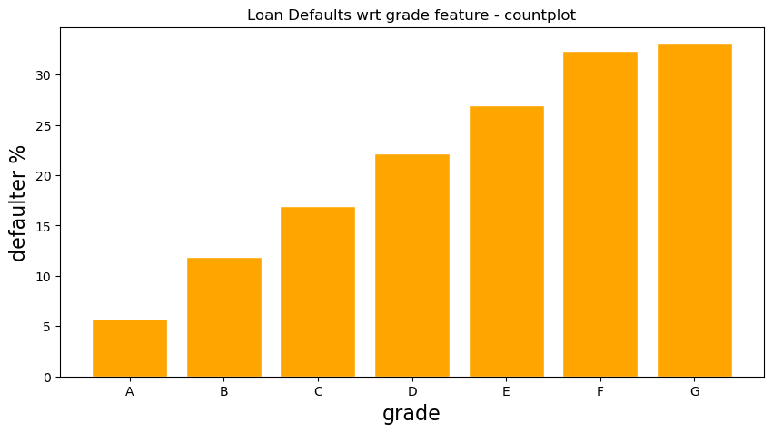
Loan Defaulters With Respect To Grade
From the graph we can infer that the defaulters rate is increasing with respect to grade, hence the chances of loan getting defaulted increases with the grade from A moving towards G

Slide 9
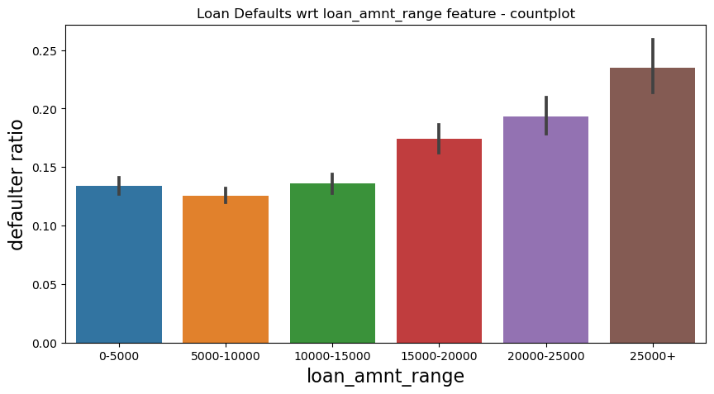
Loan Defaulters With Respect To Loan Amount
From the graph we can infer that the defaulters rate is increasing as the loan amount is getting increased

Slide 10
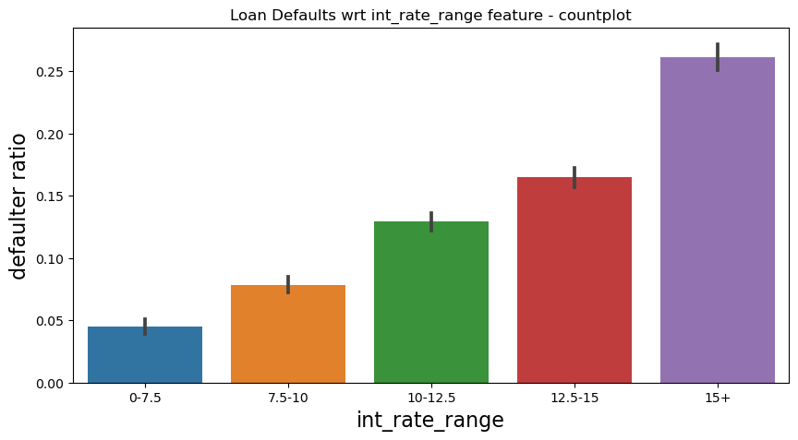
Loan Defaulters With Respect To Interest Rate
From the graph we can infer that the defaulters rate is increasing as the rate of interest is getting increased

Slide 11
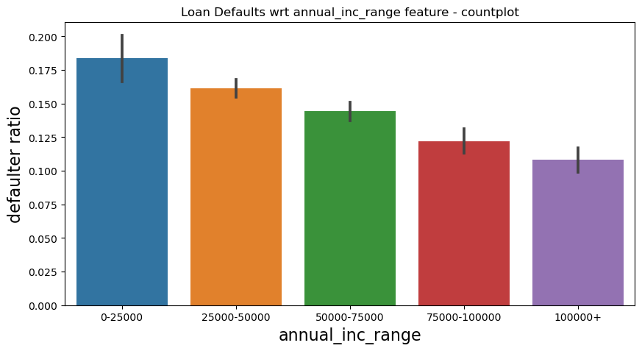
Loan Defaulters With Respect To Annual Income
From the graph we can infer that the defaulters rate is decreasing as the Annual income of the customer is higher

Slide 12

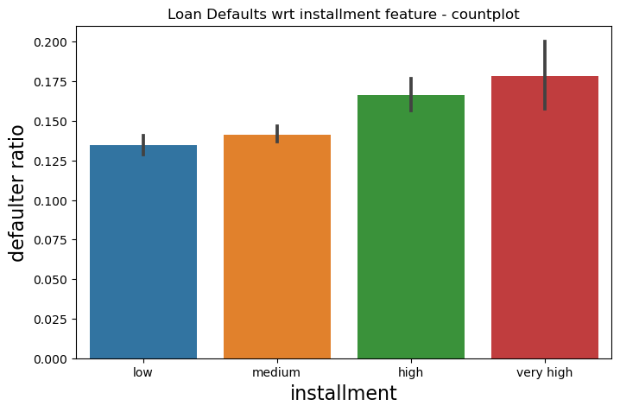
Loan Defaulters With Respect To Amount Of Installment
From the graph we can infer that the defaulters rate is increasing as the Amount of installment is high.

Slide 13
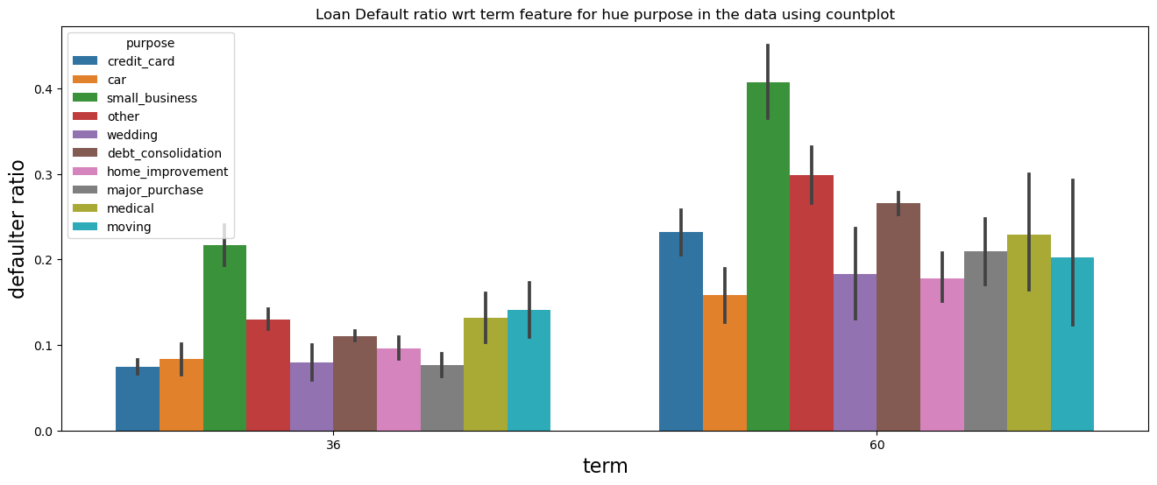
Loan Defaulters With Respect To Term And Purpose
From the graph we can interpret that the defaulters rate is increasing as the term increases from 36 to 60 but in the both the cases the maximum defaulters are who took the loan for purpose of small business

Slide 14
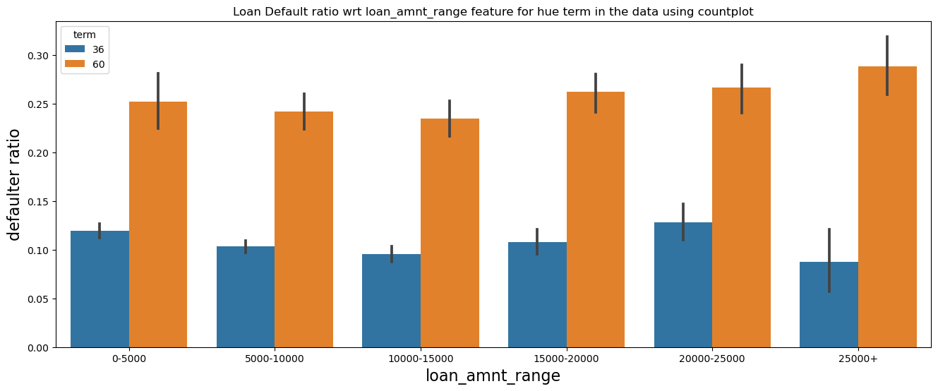
Loan Defaulters With Respect To Term And Loan Amount
With the graph we can interpret that the rate of defaults is very high for every loan amount if the term is 60 months and also there is a slight increase in defaulters as the Amount of the Loan increases

Slide 15
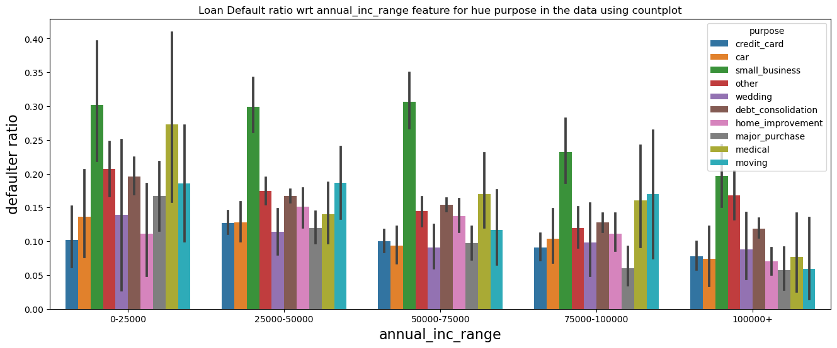
Loan Defaulters With Respect To Annual Income And Purpose
From the graph we can interpret that the defaulters rate is decreasing as the Annual income is increasing but in every case the defaulters rate is high who took the loan for the purpose of small business.

Slide 16
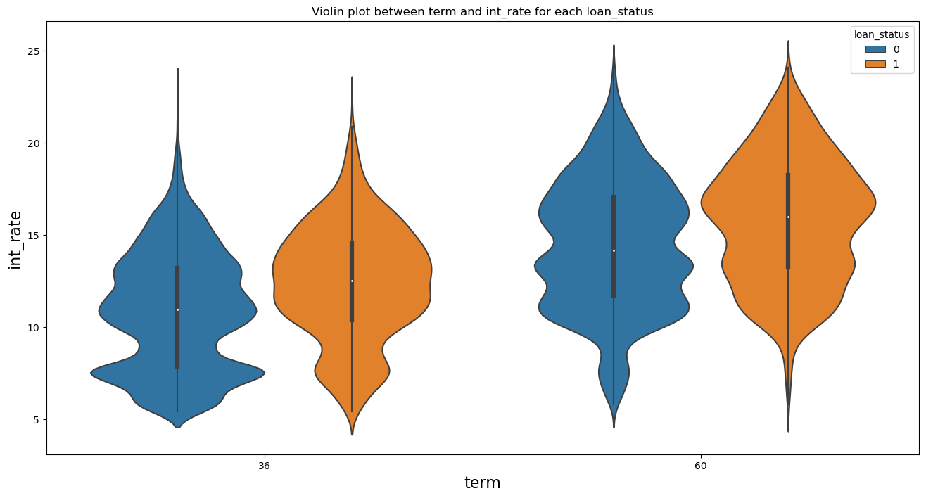
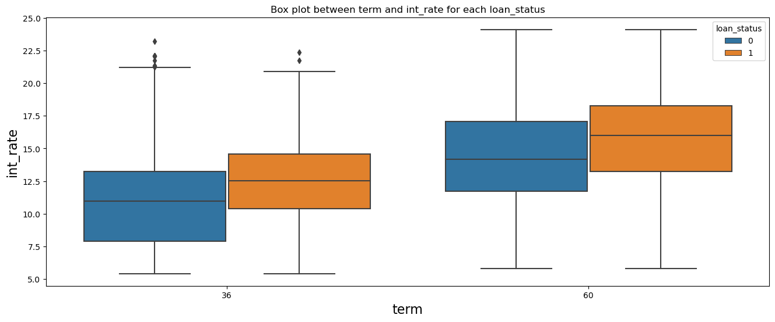
Loan Defaulters With Respect To Interest Rate And Term
From the graph we can understand that with the increase of interest rate and term the rate of defaulters also increases so this is directly proportional

Slide 17
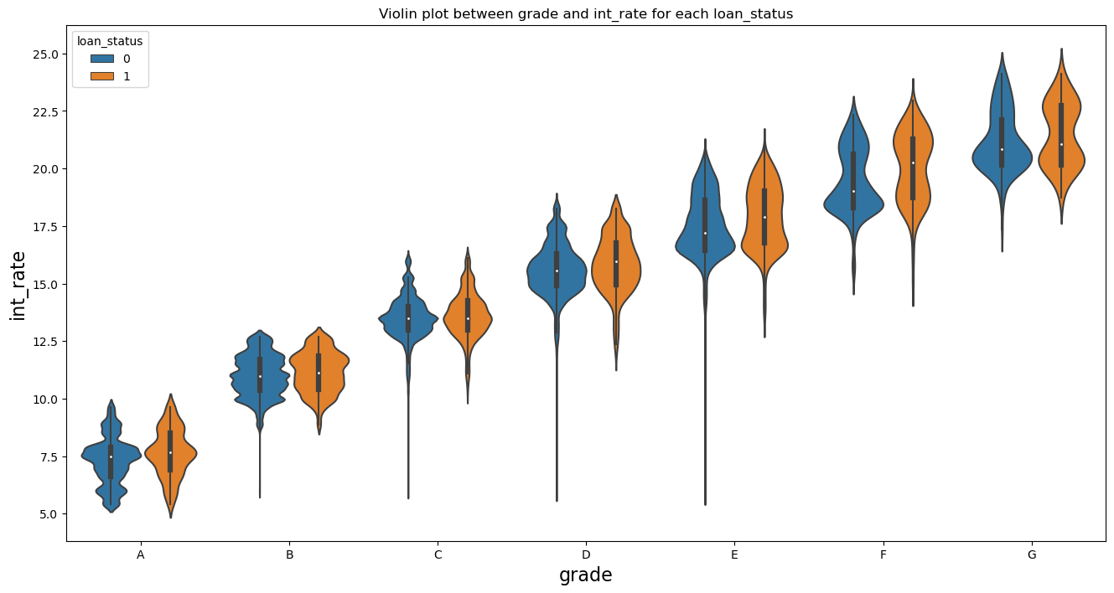
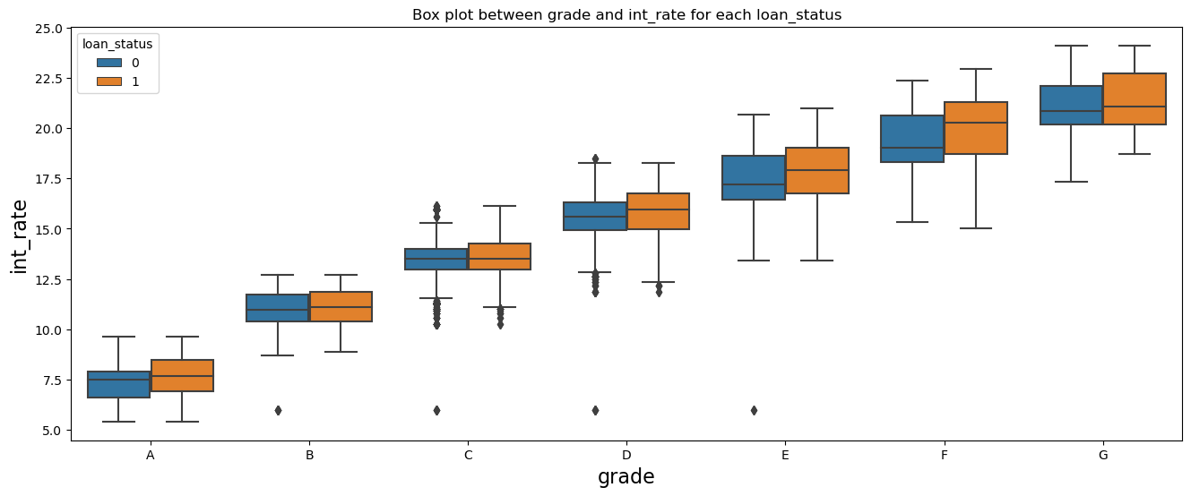
Defaulters Rate With Respect To Interest Rate And Grade
From the graph we can interpret that the with the change of grade from A to G the rate of interest as well as rate of defaulters increase

Slide 18
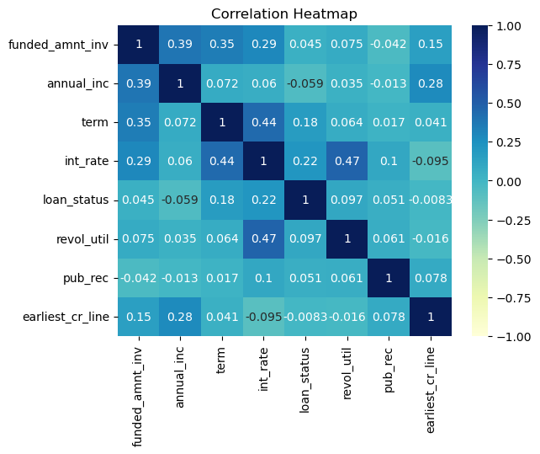
Multivariate Comparison
Hence, important related feature from above Multivariate analysis are:
term, grade, purpose, int_rate, installment, annual_inc

Slide 19

CONCLUSION AND INSIGHTS.
After analyzing the data set we can conclude the following points:-
If the term of the Loan increases the Rate of defaulters will also increase.
The chance of loan default is higher if the loan is taken for purpose of small business.
The chance of loan default increases as the grade increases from A to G.
The chances of loan default increases if the annual income of the customer is less.
The chance of loan defaulters increases if the installment amount is high.

